Slide 1
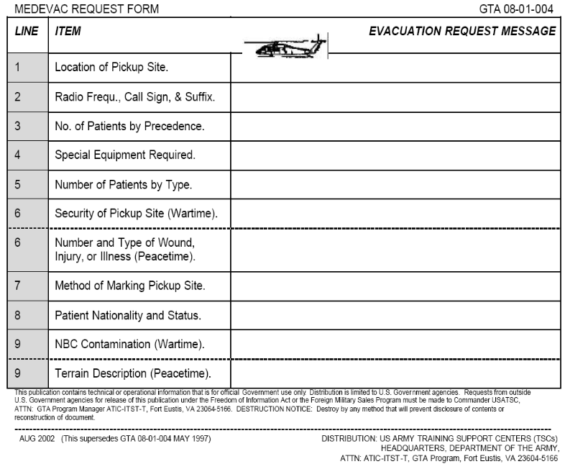
Convoy Smart Card
Leader Checklist
CREW systems placed IAW convoy planner’s tool (CPT)
Radio Check (internal, CMD, A&L)
Convoy order, pass & Execution Matrix
Map with current graphics
Strip Map with extra copies (1 per vehicle)
Sensitive items / Personnel list
Current situation/Intel brief from S-2
Risk Assessment signed by commander
Vehicle and personnel manifest
Binoculars
Communications and Digital Equipment Checklist
Antennas properly mounted and serviceable
All SINCGARS have proper fill and are on correct Freq
Internal Headsets working in platform
FBCB2, BFT, or MTS powered and working properly
Latest graphics with alarms as required uploaded on FBCB2 including Elevated Threat Zones
Commo checks from all platforms to Convoy CDR using FBCB2, and SINCGARS, ICOMS
Commo checks conducted with HQ using FBCB2, SINCGARS and cell phones
Collected all frequencies of landowners along route used during mission
Individual Checklist
Identification Tags and ID Card
Weapons Cleaning Kit
ROE Card / Unit TAC SOP
Eye, hearing protection and gloves
Individual weapon and basic load
IBAS, DPAS, ESAPI Plates and ACH
Ruck packed IAW unit SOP
M40 Protective Mask w/ J-LIST
Compass (if issued)
Knee and elbow pads
Night Vision device with extra batteries
First aid pouch w/ sterilized compression pad
Two copies of casualty feeder card (DA Form 1156)
Full Water source (canteens or camel back)
Binoculars
Digital Camera (with extra batteries)
Patrol debrief sheet readily available
Identification tags on boots
Military Drivers License (If driving, or qualified to drive)
Flashlight with extra batteries
Notebook and writing device
Sources:
Call Handbook 06-22, Security Force, JUN 06
Division Leader Book w/ Change 2, 1 APR 06
Combat Logistics Patrol Handbook 06-21, January 2006
CALL Handbook 04-27, Convoy Leader Training, NOV 04
GTA 90-01-004, Logistics Convoy Operations Smart Card, SEP 04
CJTF-7 OIF Smart Card 3, Version 1.A, 23 DEC 03
Vehicle Checklist
Vehicle Dispatch and 5988e (Current)
GTA Cards: 9 – Line MEDEVAC, UXO/IED Reports
Operational PLGR/DAGR and spare battery
Spotlight
Tow bar or tow strap
Warning Triangles and Warning Cones
Basic issue item (BII) for vehicle
Spare Tire
Class I – One box of MREs and two cases of water
Vehicle fuel and fluids topped off
Litter
VS – 17 Panel
All counter IED devices operational (CREW, Rhino, etc)
Crow / Weapon systems functioning properly (PMCS)
Concertina / Barbed wire
EOF Kit complete
CLS and contents
Body Bag
Everything secured and tied down
Fire Extinguisher
Windows and Mirrors Cleaned
Truck kit with oil, Trans Fluid, Coolant, and tie down straps
Strip Map
Weapons Checklist
Weapons clean and serviceable
Functions check conducted on all weapons
Headspace and timing tool for M2 on-hand
Gunners know sectors of fire
Ammunitions and Pyrotechnics Checklist
Appropriate Pyro on hand (per unit SOP)
M9 – 30 rounds per system
M4/M16 – 210 rounds per system
M249 – 600 to 800 rounds per system
MK19 – 3 cans (144 rounds) per system
M2 – 3 cans (300 rounds) per system
Fragmentary hand grenade
Thermite grenade
Miscellaneous
Casualty kit filled and pre-positioned
Hazardous material kits filled and pre-positioned
Conduct all appropriate rehearsals
Points of contact number updated

Slide 2


Sample Convoy Brief Operations Order
Task Organization (Internal organization for convoy – Manifest)
1. Situation
a. Enemy
1. Weather
2. Light data
3. Discuss Enemy (ID, composition/strength, Hot Spots, Location of enemy contact w/in last 72 hrs.)
b. Friendly
1. Operational Support provided by Higher HQ (Helicopter/Gun ships, QRFs, MP escort)
c. Attachments (Elements assigned to the convoy from outside the organization)
2. Mission (who, what, when, where, why/how)
3. Execution
a. Commander’s Intent
b. Concept of movement
c. Task to subordinate units (manifest)
d. Coordinating Instructions
1. Order of March (spacing of serials and locations of support elements)
2. Routes (Includes SP, CPs, rally points, mandatory halts, TCPs. Mileage should be indicated.)
3. Additional Movement Issues (speed, interval, etc)
4. Uniform
5. Actions at danger/hazard area (SOP or battle drills to be rehearsed)
Sample Convoy Brief Operations Order (cont)
3. Execution (cont)
d. Coordinating Instructions (cont)
6. Rules of Engagement
4. Service Support
a. Water Ration Plan
b. Ammunition (individual, combat loads, tracer mix)
c. Medical
d. Petroleum, oil and lubricants
e. Maintenance/Recovery Plan (internal and external)
f. Remain Overnight (RON) Facilities
5. Command and Signal
a. Commander/Positioning
b. Communications (Call Signs and Freqs)
c. Signals
d. Reports (Internal and to higher)
6. Safety / Risk Management (emphasize key risk / controls)
7. Review Timeline (displayed separately)
8. Give Time Hack
9. Ask for Questions
10. Key leader Confirmation or Backbriefs
11. FRAGOs for Long Haul routes (It is not feasible to cover in detail all of the information required to support long haul convoys. Therefore, it is essential that each leg of the extended convoy is preceded by a FRAGO. That would include separate strip map, specific intelligence of that portion of the route and any external support (QRF, MP, etc)
Sample Load Plan
20
4
23
15
2
TC
14
12
3
21
6
5
13
11
22
Engine
Gunner
22
Radio
1
6
22
8
7
DR
16
19
17
10
1
9
18
1. Fire Extinguisher 12. Warning Cones/Triangles
2. Siren 13. Fuel Cans
3. 9 Line MEDEVAC/UXO/IED 14. Water Cans
4. CLS Bag 15. Tow Strap
5. Litter Fold up 16. Tire jack, wrench
6. Ammo 5.56mm Link/ 50 cal. 17. MRE
7. VS-17 Panel Mounted 18. CPE Cooler AC Unit
8. TM/-10 19. Cooler
9. BII Tools 20. PLGR or DAGR
10. Bottled Water 21. FBCB2/BFT
11. Drip Pan/Chock Block 22. Assault packs for crew w/ JLIST/M40Mask
23. CREW System
Headset internal commo
Counter IED Principles
1. Maintain an Offensive Mindset 6. Maintain 360 degree Security
2. Develop & Maintain Situational Awareness 7. Maintain Tactical Dispersion
3. Stay Observant 8. Utilize Blast & Fragmentation
4. Avoid Setting Patterns Protection
5. Maintain Standoff 9. Utilize Technology
Close Air Support
REFERENCE: JP 3-09.3 Joint Tactics, Techniques, and Procedures for Close Air Support (CAS) (Oct 2004)
Do not transmit line numbers. Units of measure are standard unless briefed. Lines 4, 6, and restrictions are mandatory read back (*). JTAC may request additional read back:
JTAC: “________________, this is ___________________”
Type ____________ (1,2, or 3) Control”
1. IP/BP: “__________________”
2. Heading: “____________________________________”
(Deg Magnetic) (IP/BP to Target)
Offset: “______________________________________”
(Left/Right) (When required)
3. Distance: “____________________________________”
(IP to Target in nautical miles/BP to Target in Meters)
4. * Target Elevation: “_____________________________”
(in feet/MSL)
5. Target Description: “_____________________________”
6. * Target Location: “______________________________”
(Lat/Long, grid coords to include map datum [e.g. WGS-84], offsets or visual description)
7. Type Mark: “______________” Code: “______________”
(WP, Laser, IR, Beacon) (Actual Code)
8. Location of Friendlies: “__________________________”
(From target, cardinal directions and distance in meters)
9. Egress: “______________________________________”
Remarks (as appropriate): “_______________________”
(Restrictions *, Ordinance Delivery, Threats, FAH, Hazards, ACAs, Weather, TGT Info, SEAD,
LTL, GTL (degrees magnetic north), Night Vision, Danger Close [plus commander’s initials])
Time on Target (TOT): “__________________” or
Time to Target (TTT): “___________________”
“Standby______________ plus _____________Hack.”
(minutes) (seconds)
NOTE: When identifying position coordinates for joint ops, include map data. Grid coordinates
must include 100,000 meter grid identification
5/25m Meter Check
9 Line Explosive Hazard Spot Report
Line 1: Date time group discovered (Command policy will dictate Local or Zulu time)
Line 2: Reporting Activity (UIC / Unit designation), Location (8 Digit Grid including landmarks and reference points)
Line 3: Contact Method: (Radio Freq / Call Sign or Telephone number If using telephone number provide point of contact)
Line 4: Type of Munition: (Dropped, Projected, Placed or Thrown)
Line 5: NBC Contamination: Yes or No, known or suspected NBC contamination. If Yes, report type of agent if known / identified.
Line 6: Resource Threatened: (What resource is threatened – is it a critical asset?)
Line 7: Impact on Mission: (How the UXO is affecting the mission)
Line 8: Protective Measures Taken: (Unit emplaced protective measures)
Line 9: Recommended Priority: (Immediate, Indirect, Minor, No Threat)
The 5/25m Check is designed to avoid stoppage near the kill zone of an IED. Crews should continue to scan outward and maintain 360-degree situational awareness at all times.
-Crews conduct a 5 meter check with ballistic windows up.
-Prior to and during vehicle halt, crew members actively scan around vehicle for possible IEDs, advising TC of abnormalities
5 Meter Check (Short Halt)
-Long Halt procedures are implemented when situation warrants the dismounting of soldiers (i.e. maintenance halt, TCP, etc.)
-Before dismounting a group, TCs designate a minimum number of personnel to dismount, close doors, check underneath and around vehicle for possible IEDs, and return; avoid using drivers/gunners.
5M
25 Meter Check (Long Halt)
25M
-At all times during the 5/25m Check crews need to maintain vigilance and continue to scan outward in order to deter/discover possible triggermen and secondary attacks.
100/300M
100/300 Meter Scan (Long Halt)

